Slide 1
Using the fx-CG50 for number and algebra
Calculator functionality

Slide 2
How our teaching resources are designed for the classroom

Slide 3
I can use the fx-CG50 to perform calculations with numbers and solve equations numerically.

Slide 4
An equation is used to show 2 expressions that are equal to each other.
Equations which represent different relationships between the same variables are called simultaneous equations.

Slide 5

Using the fx-CG50 for number and algebra
Solving equations graphically
Solving equations numerically

Slide 6



Solving equations graphically
Calculators can do a lot numerically.
The fx-CG50 can also solve graphically.
Aisha
Sam

Slide 7
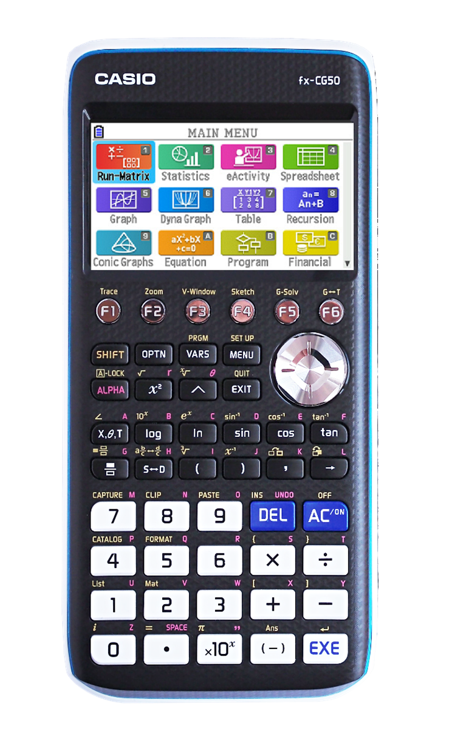
Solving equations graphically
The fx-CG50 allows you to draw graphs and then analyse them.
From the main menu, navigate to the ‘Graph’ option and press ‘EXE’.

Slide 8

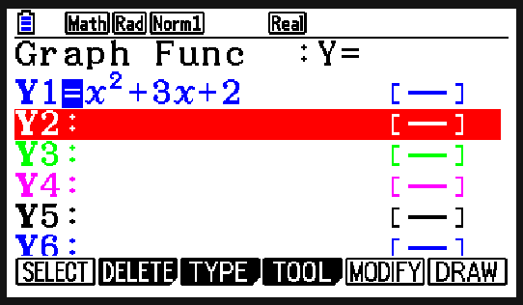
Solving equations graphically
You can enter the equation of the graph on this screen, using the button to input the variable x.

Slide 9
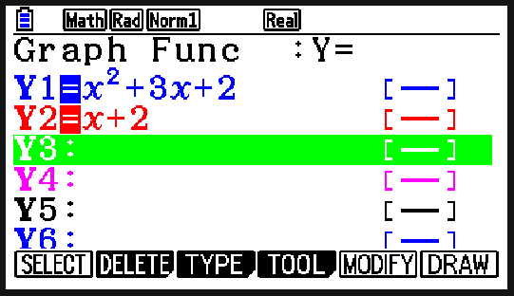
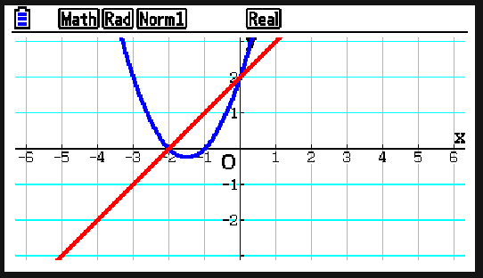
Solving equations graphically
When ready, press F6 to draw the graph. If you have entered the equations for multiple graphs, then the calculator will draw them all.

Slide 10

Solving equations graphically
The calculator can only plot one graph at a time.
There are spaces for up to 20 equations of graphs to be entered.

Slide 11
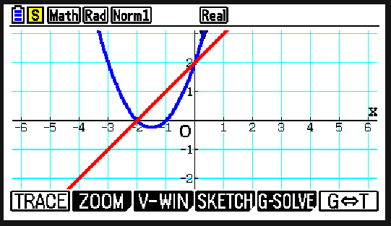
Solving equations graphically
Once you have drawn your graph(s), you can use the ‘G-Solve’ menu to analyse the graph(s).
Pressing ‘SHIFT’ followed by F5 lets you access ‘G-Solve’.

Slide 12
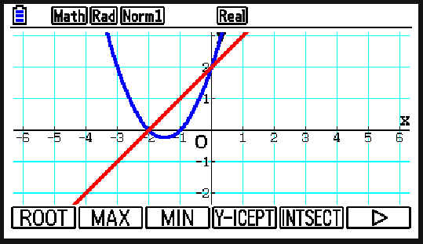
Solving equations graphically
You can find the root(s), the maximum/minimum point(s), the y-intercept and the points of intersection if you have multiple graphs.

Slide 13

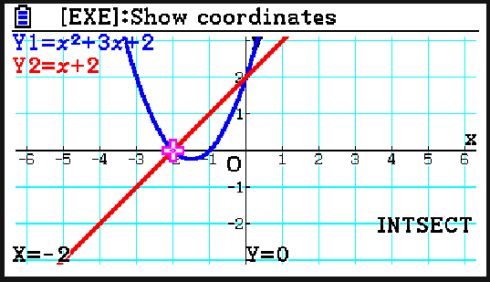
Solving equations graphically
The first point of intersection is when x = −2, y = 0
The arrows can be used to select the next point.

Slide 14
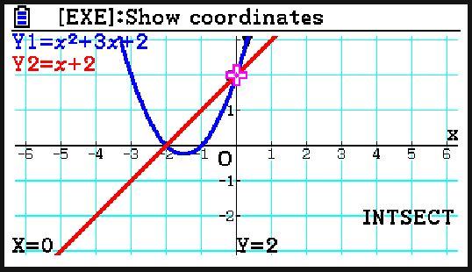
Solving equations graphically
What are the coordinates of the second point of intersection?
(0, 2)

Slide 15
Solving equations graphically
1) Use your calculator to solve these pairs of simultaneous equations.
a)
y = x − 3
y = 3x + 6
b)
6y − x = 14
x + 3y = 13

Slide 16
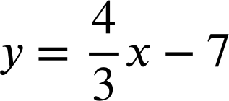
Solving equations graphically
2) For each pair of simultaneous equations, write down what your calculator says when you try to solve them graphically. Why do you think the calculator gives this output?
a)
35x − 7y = 63
y = 5x + 1
b)
3x + 4y = 7
c)
25x − 5y + 5 = 0
y = 5x + 1

Slide 17
Solving equations graphically
3) Use your calculator to estimate the solutions to this pair of simultaneous equations to 3 d.p.
y = 3x − x²
y = 1.7 − 0.8x

Slide 18
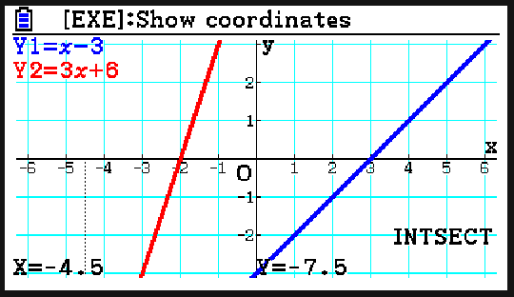
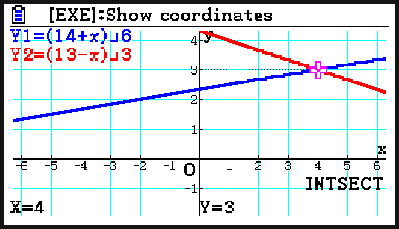
Solving equations graphically
1) Use your calculator to solve these pairs of simultaneous equations.
a)
y = x − 3
y = 3x + 6
b)
6y − x = 14
x + 3y = 13
x = − 4.5, y = − 7.5
x = 4, y = 3

Slide 19
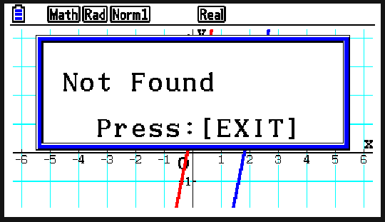
Solving equations graphically
E.g.
The calculator could not find a solution as there is no point of intersection.
The lines are parallel as they have the same gradient.
2) For each pair of simultaneous equations, write down what your calculator says when you try to solve them graphically. Why do you think the calculator gives this output?
a)
35x − 7y = 63
y = 5x + 1

Slide 20
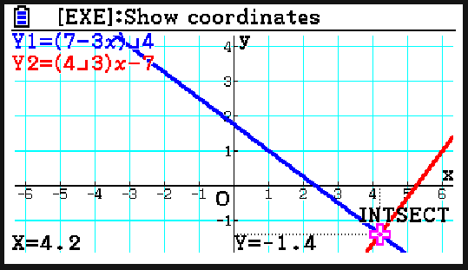
Solving equations graphically
E.g.
The lines have one intersection which the calculator was able to find. It displays the coordinates of the point of intersection.
2) For each pair of simultaneous equations, write down what your calculator says when you try to solve them graphically. Why do you think the calculator gives this output?
b)
3x + 4y = 7

Slide 21
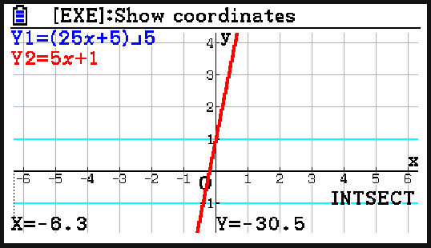
Solving equations graphically
E.g.
The calculator gives a point of intersection. Scrolling reveals that there are many points of intersection. This is because the two lines are the same so they have infinitely many solutions.
2) For each pair of simultaneous equations, write down what your calculator says when you try to solve them graphically. Why do you think the calculator gives this output?
c)
25x − 5y + 5 = 0
y = 5x + 1

Slide 22
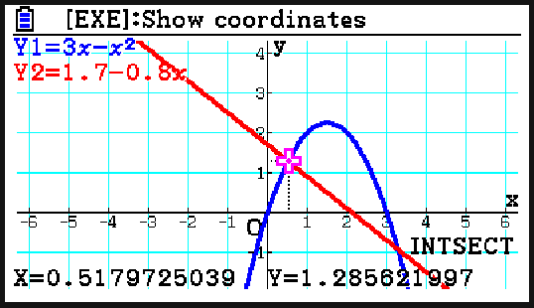
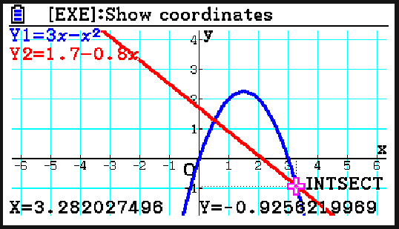
Solving equations graphically
3) Use your calculator to estimate the solutions to this pair of simultaneous equations to 3 d.p.
y = 3x − x²
y = 1.7 − 0.8x
x = 0.518, y = 1.286
x = 3.282, y = − 0.926

Slide 23
Using the fx-CG50 for number and algebra
Solving equations graphically
Solving equations numerically

Slide 24
Solving equations numerically
So does this calculator only solve equations graphically?
Nope! It can even deal with formulas.
Aisha
Sam

Slide 25
Solving equations numerically
The fx-CG50 allows you to solve equations numerically and evaluate formulas.
From the main menu, navigate to the ‘Equation’ option and press ‘EXE’.

Slide 26
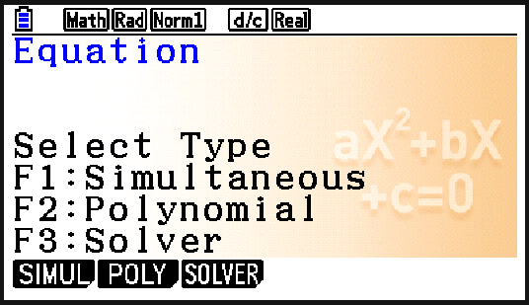
Solving equations numerically
Once ‘Equation’ has been chosen, select ‘Solver’ by pressing F3.

Slide 27

Solving equations numerically
Enter the equation or formula, using the ‘ALPHA’ button to select different variables as required.
What is the value of a when s = 210, u = 2 and t = 5?

Slide 28
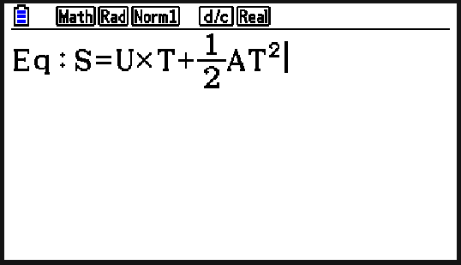
Solving equations numerically
What is the value of a when s = 210, u = 2 and t = 5?
Remember to use the ‘ALPHA’ button to enter the variables.
It does not matter that they appear as capital letters.

Slide 29
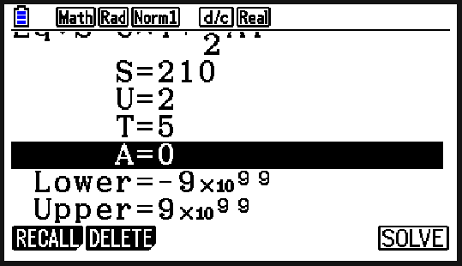
Solving equations numerically
What is the value of a when s = 210, u = 2 and t = 5?
Pressing ‘EXE’ then allows you to set the values for the variables.
Enter the known values and leave the one you want to find as 0.

Slide 30
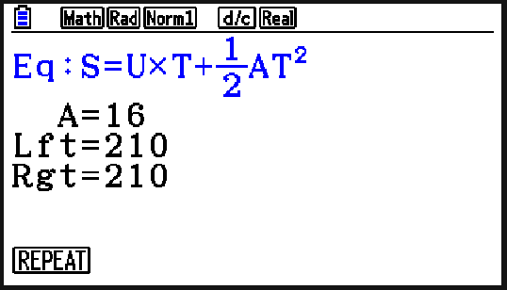
Solving equations numerically
What is the value of a when s = 210, u = 2 and t = 5?
Pressing ‘SOLVE’ (F6) then produces the value of the remaining variable.

Slide 31
Solving equations numerically
The ‘Solver’ mode can only handle linear equations
The ‘Solver’ mode lets you determine the value of any variable in a formula.

Slide 32
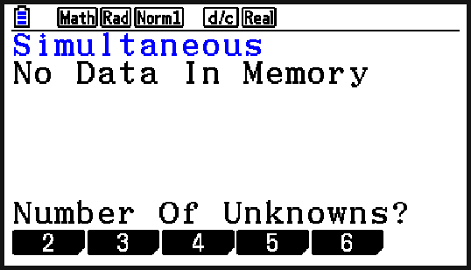
Solving equations numerically
Our calculator can also solve pairs of linear simultaneous equations.
Once ‘Equation’ has been chosen, select ‘Simultaneous’ by pressing F1.
We are dealing with simultaneous equations with two unknowns so we select 2.

Slide 33
Solving equations numerically
Your calculator will only accept equations in the form ax + by = c so it may be necessary to rearrange before inputting.
w + h + 8 = 0
x + y = −8
h = 4w − 17
4x − y = 17
The calculator uses x and y so it is important that you know which variable x is representing and which variable y is representing.

Slide 34
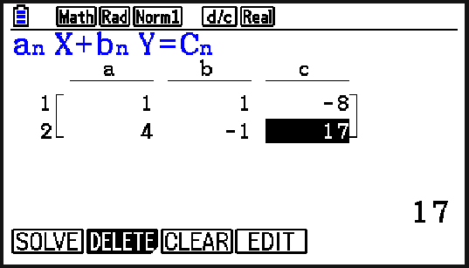
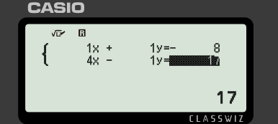
Solving equations numerically
Your calculator will only accept equations in the form ax + by = c so it may be necessary to rearrange before inputting.
w + h + 8 = 0
x + y = −8
h = 4w − 17
4x − y = 17
Be careful with any negative values.

Slide 35
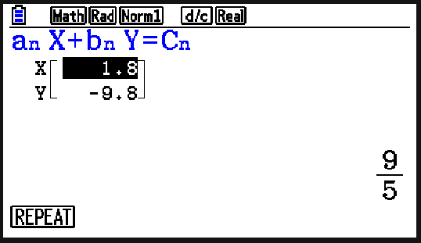
Solving equations numerically
Your calculator will only accept equations in the form ax + by = c so it may be necessary to rearrange before inputting.
w + h + 8 = 0
x + y = −8
h = 4w − 17
4x − y = 17
Pressing ‘SOLVE’ (F1) displays both values.
We can interpret this as w = 1.8 and h = −9.8

Slide 36
Solving equations numerically
You can enter any pair of simultaneous equations into your calculator without needing to rearrange.
Equations must be in the form ax + by = c
Sometimes it is necessary to rearrange first.

Slide 37
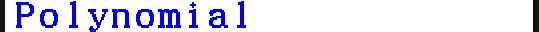
Solving equations numerically
You can solve quadratic equations by selecting ‘Equation’ and then ‘Polynomial’. Choose the general form for the polynomial you want to solve.

Slide 38
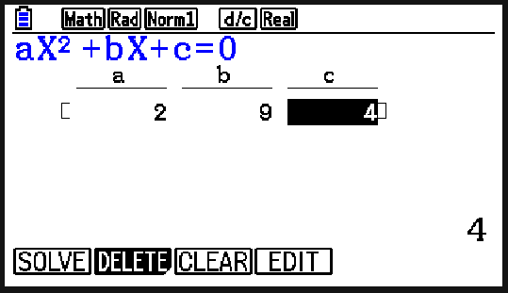
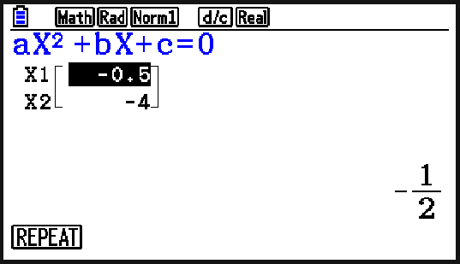
Solving equations numerically
Solve 2x² + 9x + 4 = 0
Your calculator will only accept equations in the form ax² + bx + c = 0 so it may be necessary to rearrange first.
Press ‘SOLVE’ (F1) to solve.

Slide 39
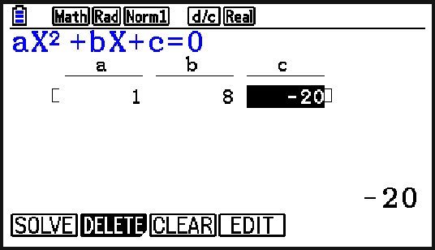
Solving equations numerically
Use your calculator to find the solution(s) to x² + 8x − 20 = 0
x = 2
x = −10

Slide 40
Solving equations numerically
1) Solve the following pairs of simultaneous equations using your calculator.
a) b)
2a + 3b = 1
2b + a = 8
−a + 4b = 8
2b + 3 = 7a

Slide 41
Solving equations numerically
2) Calculate the solutions to these quadratic equations.
a) −x² − 8x + 20 = 0
b) x² + 8x − 19 = 0
c) x² + 6x + 8 = 3
d) 5x² − x + 5 = 3x² − 10x − 2

Slide 42
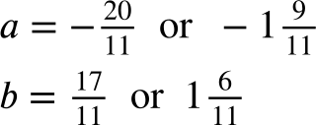
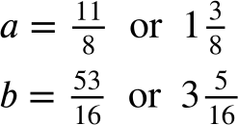
Solving equations numerically
1) Solve the following pairs of simultaneous equations using your calculator.
a) b)
2a + 3b = 1
2b + a = 8
−a + 4b = 8
2b + 3 = 7a

Slide 43
Solving equations numerically
2) Calculate the solutions to these quadratic equations.
a) −x² − 8x + 20 = 0 x = −10 or x = 2
b) x² + 8x − 19 = 0
c) x² + 6x + 8 = 3 x = −5 or x = −1
d) 5x² − x + 5 = 3x² − 10x − 2 x = −1 or x = −3.5

Slide 44
Using the fx-CG50 for number and algebra
Some calculators can perform more than just basic calculations.
The fx-CG50 can solve equations graphically and numerically.

Slide 45

© Oak National Academy 2025.
Produced in partnership with Casio and Mathematics in Education and Industry.
Licensed on the Open Government Licence v3.0, except where otherwise stated. See Oak terms and conditions.

